Slide 1

TDD & CI/CD
WEBD 5201 WEB DEVELOPMENT FRAMEWORKS

Slide 2

Announcements
Dec 12th, 2023 – Final Quiz SpringMVC, SpringBoot & Web Development Case Study
Assignment 5 Deadline Nov 28th, 2023
Assignment 6 Deadline December 12th, 2023

Slide 3

TDD – Test Driven Development
Test-Driven Development (TDD) is a software development approach where tests are written before code. Developers iteratively write tests, code, and refactor. It enhances code quality, encourages small and frequent improvements, and ensures that changes don't break existing functionality, fostering a robust and maintainable codebase.

Slide 4

TDD Steps
Write the test
Run the test
Write the code
Run the code
Refactor the code
Repeat

Slide 5

Advantages
Early Issue Detection
Improved Code quality
Regression Testing
Design Improvement
Confidence in the change

Slide 6

TDD Use cases
Complex Calculation
Mission critical applications
Financial Applications

Slide 7

Discussion
What are some of the disadvantages of using this approach?

Slide 8

Disadvantages
Initial Learning curve
False Sense of security
Time Consuming

Slide 9

CI/CD Pipeline
Continuous Integration - Developers regularly integrate their code changes into a shared repository. Automated builds and tests will ensure the code change does not break the existing functionality.
Continuous Deployment – After the CI, the code automatically deployed in various environments.

Slide 10

Tools
Jenkins
Gitlab CI/CD
Travis CI
Github Actions
CircleCI

Slide 11
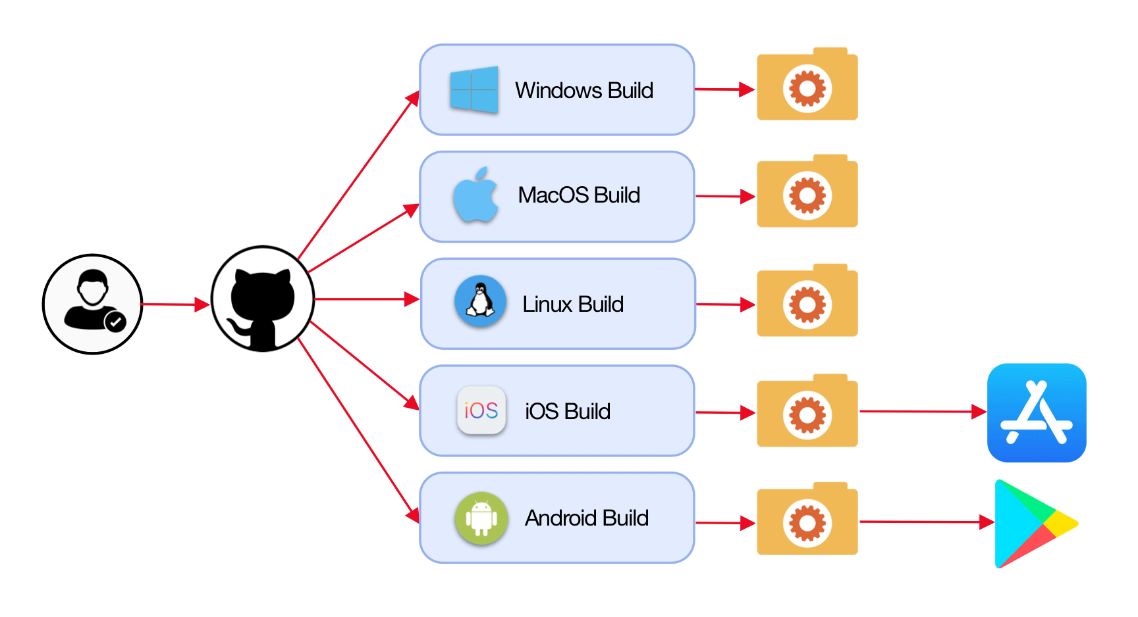

Slide 12
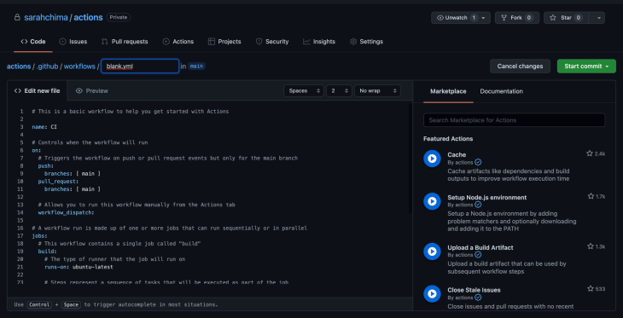

Slide 13
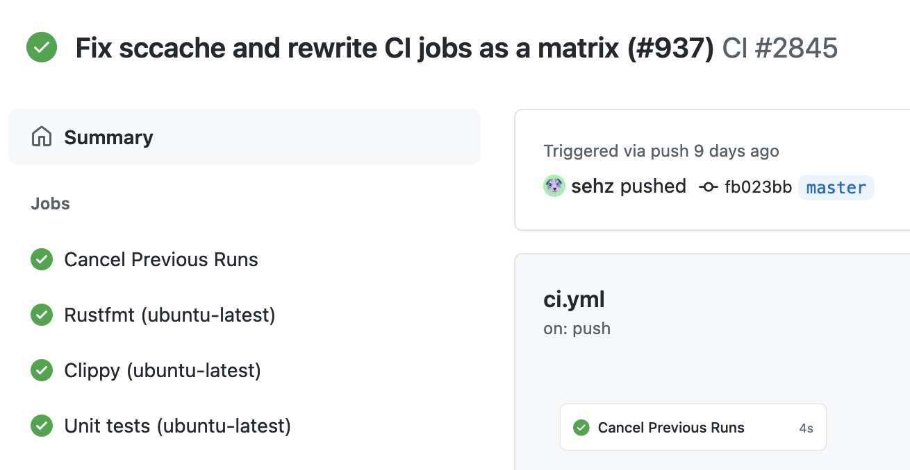

Slide 14

Questions?

